Slide 1

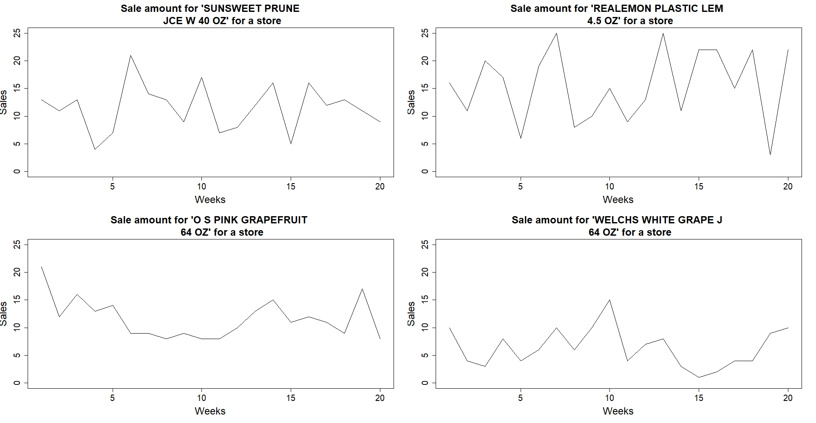
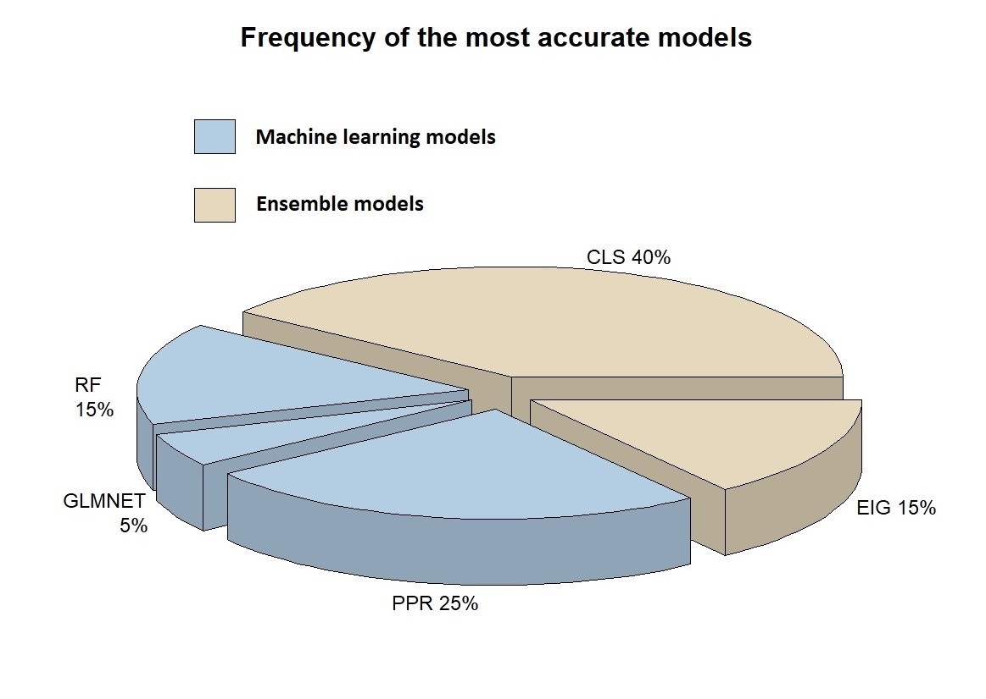
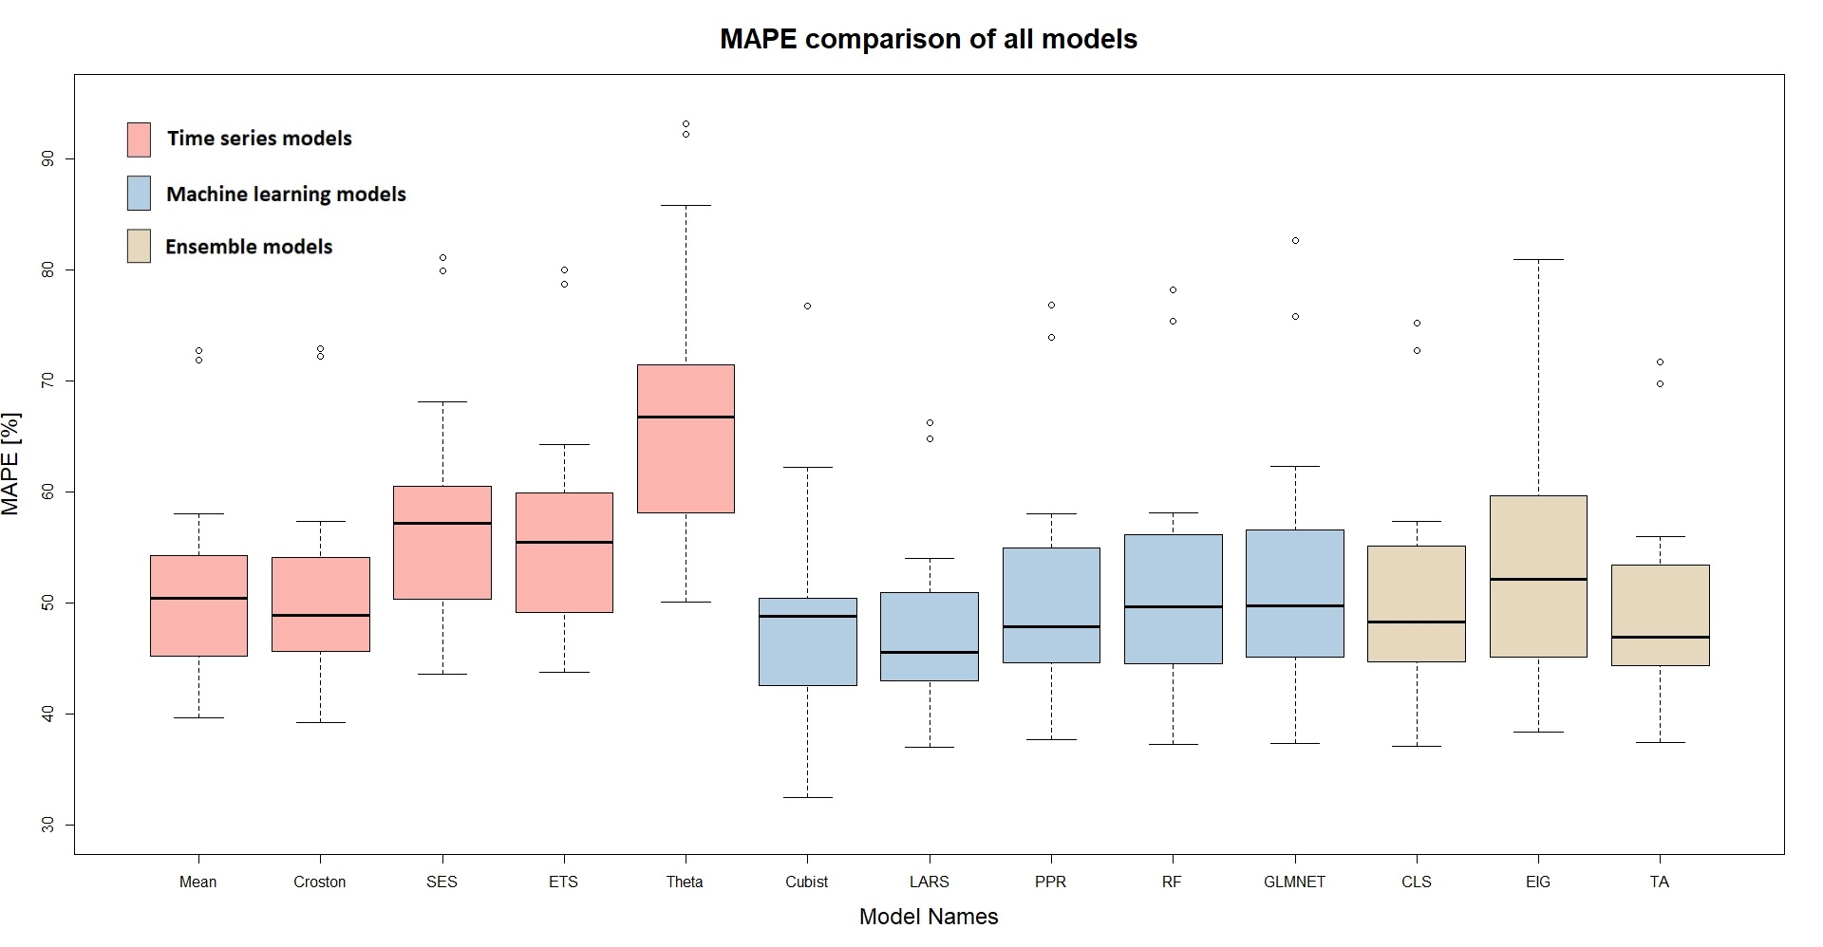
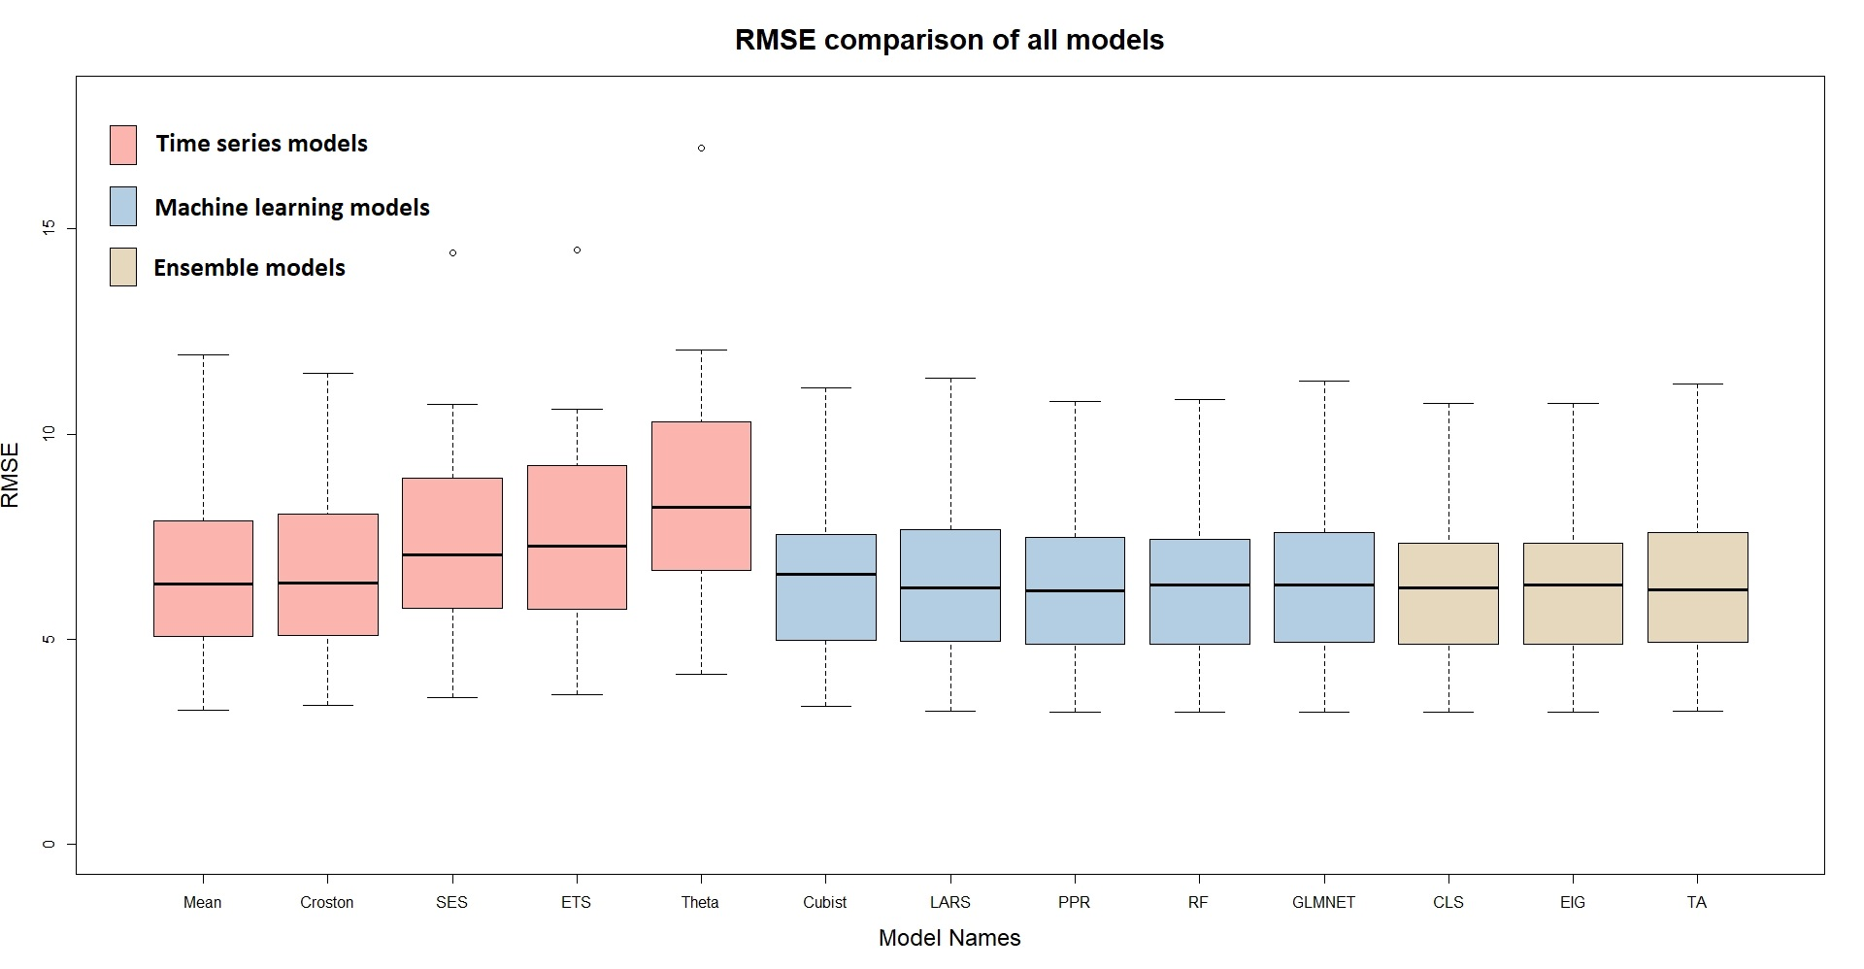
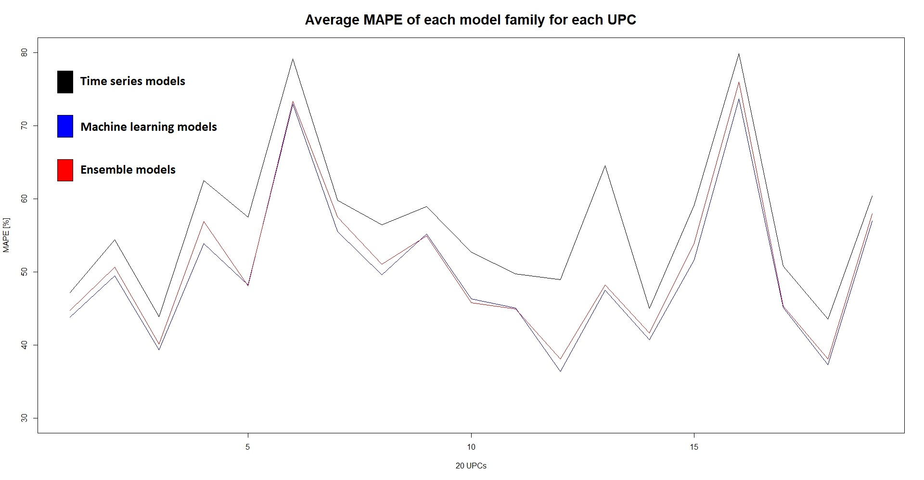
Comparison of Ensemble, Time Series and Machine Learning Forecasts
Onur YAGLI
A*STAR SIMTech
INTRODUCTION
DATA & METHODS
RESULTS
CONCLUSIONS
Fast-moving-consuming-goods (FMCG) requires accurate forecasting.
Meeting the demand is vital for every company that’s why companies need forecasting for better control on production, distribution, and management of supply-chain.
Time series forecasting, machine learning forecasting, hierarchical forecasting, ensemble forecasting and many others as well are the ways to generate a forecast.
In certain circumstances, some models provide better results; in other circumstances, the converse may be true. No model performs consistently well under all circumstances.
Since no model performs consistently well, a FMCG forecaster may have to select model based on empirical evaluations that results in model selection risk.
However, ensemble is a commonly-used technique for reducing the model selection risk makes each model to contribute in final forecast. Hence, the forecaster does not rely on a single model.
Besides ensemble reduces model selection risks, it often results in more accurate and robust forecasts than of component models.
The dataset that used in this research is provided by the James M. Kilts Center, University of Chicago Booth School of Business with a collaborative effort by the Dominick’s Finer Food (DFF).
The data are a collection of FMCG from 29 categories, such as bottled juices or shampoos, and only bottled juice data are considered.
The Dominik’s dataset contains universal product code (UPC) which identifies the product name and the manufacturer, and the total sales quantity for each product are attempted to estimate. 19 UPC are considered which has the most valid data points in this research.
Each forecast model has different underlying prediction mechanisms, and 13 models are used in the research.
Five of models belong to time series forecasting method which are mean, Croston, (simple exponential smoothing) SES, (exponential smoothing) ETS, Theta.
The other 5 models belong to machine learning family, which are Cubist, (least angle regression) LARS, (projection pursuit regression) PPR, (random forest) RF, (generalized linear models with elastic net) GLMNET.
Rest of the models belong to Ensemble techniques which are (constrained least squares) CLS, (trimmed bias-corrected eigenvector) EIG4, (trimmed mean or trimmed average) TA.
Based on error metrics, mean absolute percentage error and root mean square error, it is found that ensemble resulted in more accurate forecast in 55% of the considered case studies.
Although ensemble models may not guarantee more accurate forecast results, it may help to mitigate substandard model selection risks.
Instead of searching a model for accurate forecasting, using ensemble forecasting may be a better option for many cases.
REFERENCES
Yang, D., Goh, G. S., Xu, C., Zhang, A. N., & Akcan, O. (2015, October). Forecast UPC-level FMCG demand, Part I: Exploratory analysis and visualization. In 2015 IEEE International Conference on Big Data (Big Data) (pp. 2106-2112). IEEE.
Yang, D., Goh, G. S., Jiang, S., Zhang, A. N., & Akcan, O. (2015, October). Forecast UPC-level FMCG demand, Part II: Hierarchical reconciliation. In 2015 IEEE International Conference on Big Data (Big Data) (pp. 2113-2121). IEEE.
Yang, D., Goh, G. S., Jiang, S., & Zhang, A. N. (2016, December). Forecast UPC-level FMCG demand, Part III: Grouped reconciliation. In 2016 IEEE International Conference on Big Data (Big Data) (pp. 3813-3819). IEEE.
Yang, D., & Zhang, A. N. (2018, December). Forecast UPC-Level FMCG Demand, Part IV: Statistical Ensemble. In 2018 IEEE International Conference on Big Data (Big Data) (pp. 3180-3185). IEEE.
Kuhn, M., & Johnson, K. (2013). Applied predictive modeling (Vol. 26). New York: Springer.
Hyndman, R. J., & Athanasopoulos, G. (2018). Forecasting: principles and practice. OTexts.
Weiss, Christoph E., Eran Raviv, and Gernot Roetzer. "Forecast Combinations in R using the ForecastComb Package." R Journal 10.2 (2018).
Time Series Models
Mean
Croston
Ensemble Models
Theta
SES
ETS
Machine Learning Models
GLMNET
Cubist
LARS
PPR
Random Forest
TA
CLS
EIG4
OBJECTIVES
Improving forecast accuracy using ensemble techniques.
Improving decision-making with more accurate forecasts.
Accuracy benchmarking of ensemble and other forecasting techniques.

